Slide 1
Python 3.01 & 3.02
Functions Built In and Defined

Slide 2
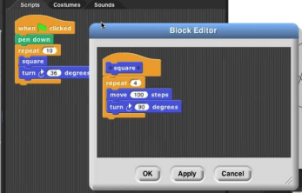
Functions
Blast from the past!
Remember custom blocks in SNAP?

Slide 3
Functions
In Python a function is like a custom block. A specific sequence of statements is run each time a Function is called.
type(name)
print(“Hello World”)

Slide 4
Functions
Functions can either be Built In or Defined
Built-In Functions are Functions that are built by someone else. Python has many built-in functions available by default that we have been using.
type(name)
print(“Hello World”)

Slide 5

Functions
Functions can either be Built In or Defined
Other Built-In Functions can be imported via modules. Modules contain libraries of Functions that can be imported for use. For example the random module contains functions for randomizing

Slide 6
Functions
Functions can either be Built In or Defined
As a programmer you can also Define your own functions as well. Just like when creating a custom block in Snap your Defined Function will be run the same way each time it is called
def my_first_function():
print(“This is my first function”)
my_first_function()

Slide 7
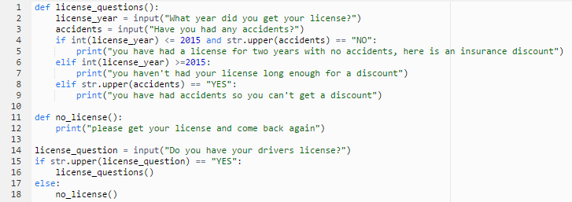
Functions
Functions can either be Built In or Defined

Slide 8
Functions
Flow of Execution
Functions must be defined before they are called
RIGHT WAY
def print_name():
print(“Mike”)
print_name()
WRONG WAY
print_name()
def print_name():
print(“Mike”)

Slide 9
Functions
Arguments
Defined Functions can take Arguments
def print_twice(arg1):
print(arg1)
print(arg1)
Item_to_print = input(“What should I print?”)
print_twice(item_to_print)

Slide 10
Functions
Contracts
Each function should include a Contract. A Contract is a comment that explains the Functions use.
The Contract should include:
Name
Purpose
Inputs
Returns
# Name: birthday_song # Purpose: birthday_song prints out a personalized birthday song # Input: name, string # Returns: none def birthday_song(name):

